Slide 1
R75 Training Overview for ATC Partners
Check Point Education Services Team

Slide 2
Agenda
Education Services Team
Courseware Overview for R75 Material
  CCSA
  CCSE
Courseware Overview for NEW Training Blades
Certification Update
ATC Partner Update – Portal Resources
Notes:
Webcast Agenda -

Slide 3


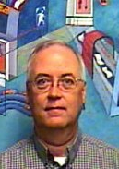
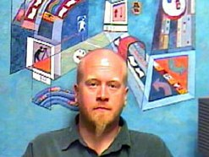

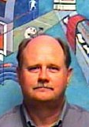
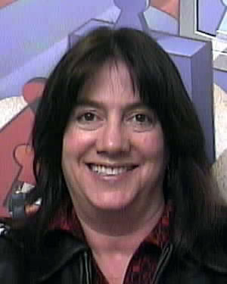
Education Services Org Chart
Training Content Development
Training Partner Programs
Head of Education Services
Toni Ponder
ATC Coordinator
Mark Hoefle
Courseware
Developer
Mark Hoefle
Courseware
Developer
Steve Luc
Courseware
Developer
Ronen Koehler
Certification
Channel Marketing
Joey Witt
Courseware
Developer
Joey Witt
Courseware
Developer
Ken Finley
Certification
Karen Pavis
Notes:
Here’s our Education Services team. Each team member helps contribute to your ATC success.

Slide 4

Check Point Education – What’s New
New Comprehensive Security Curriculum
training for security professionals of all levels
Faster Certification Renewals
with NEW! modular Training Blades
More technical content
new “under the hood” troubleshooting and labs
Notes:
R75 Training Material delivers the 3D Security concept to the ATC partners with a new curriculum, faster certification updates and more technical content of the material. We are also excited the new mobile learning training material with the Training Blades.
During this webcast, we will address the technical overview of the CCSA, CCSE and Training Blade courses. We will address the revised certification process for an easy update path for old certifications. Lastly, I will provide an overview of the ATC partner resources available to you at the specialized ATC partner portal
4

Slide 5


R75 CCSA
  Joey Witt is our presenter to the R75 CCSA course overview

Slide 6
R75 CCSA
Topics Covered (3-day class)
  Introduction to Check Point Technology
  Deployment Platforms
  Introduction to the Security Policy
  Monitoring Traffic and Connections
  Using SmartUpdate
  User Management and Authentication
  Identity Awareness
  Introduction to Check Point VPNs
Notes:
You’ll see that the R75 version of CCSA is very similar to the previous course. The major changes include moving some content from CCSA to CCSE and adding a new section for Identity Awareness.
Topics moved to CCSE include upgrading, clustering, and encryption with Certificates. Items that were removed completely include messaging and Content Security Servers, and the overview of encryption and VPNs. The Content Security configuration is changing so we removed this information and worked it into the new IPS blade. As for the Encryption chapter, we felt that this was basic knowledge that the students should have before taking this course.
With these changes, R75 CCSA is structured to be taught in three days by ATCs.

Slide 7

R75 CCSA
Identity Awareness
  Introduction to Identity Awareness
  Enabling Identity Awareness
  Defining Access Roles
  Using Access Roles in the Firewall Rule Base
Notes:
The new Identity Awareness chapter highlights this new feature. The material also includes a new lab to illustrate how to configure and test Identity Awareness.

Slide 8
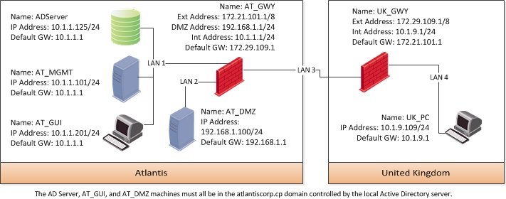
R75 CCSA
Lab Topology
Notes:
The CCSA lab topology adopts the same philosophy used in CCSE, in that we are deploying a completely sandboxed environment. Each student will have the same topology, as show here. This allows the students to control more virtual machines and eliminates the need for partners. Since internet connectivity is not required for CCSA labs, it is not configured by default.
Since all Check Point products are installed during the class, the 15 day evaluation licenses included with the software are used. No additional licensing is required.

Slide 9
R75 CCSE
  Steven Luc is our presenter for the R75 CCSE course overview

Slide 10
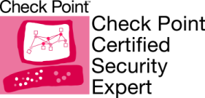
CCSE R75
CCSE R75 Topics
  I. Advanced Firewall
    Advanced Firewall & Troubleshooting
    Advanced User Management
  II. Advanced Upgrading
    a. Backup & Restore
    b. SMS Upgrade and Database Migration
    c. Upgrading Cluster Deployments
  III. Advanced Clustering
    a. Clustering Overview
    b. Acceleration Overview
    c. Maintenance Tasks and Tools
  IV. Advanced VPN
    a. IPSEC VPN Overview
  V. Advanced Reporting
Notes:
The CCSE Course has been re-tooled to approach a more “Expert Level” approach to the core Check Point technologies. The labs were designed with an “As close-to-real-world-as-possible” intention, to provide participants with practical application of concepts covered.

Slide 11
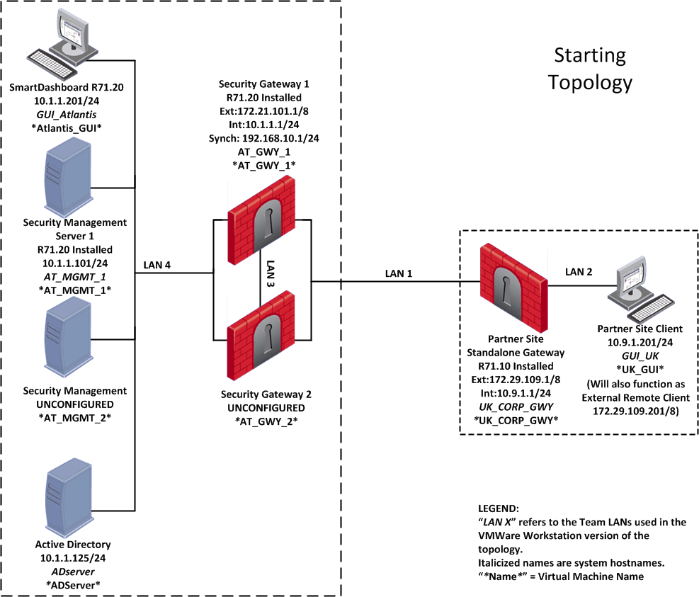
R75 CCSE
Starting Lab Topology
Notes:
The CCSE R75 Topology employs a sandbox mentality, in that all sites are in a self-contained environment without need for internet access. As the structure of the topology changes over the course of the labs, a “Starting” topology map and a “Final” topology map are included in the lab book to show participants the end result of the addition of clustering for Gateways and Management High Availability.

Slide 12
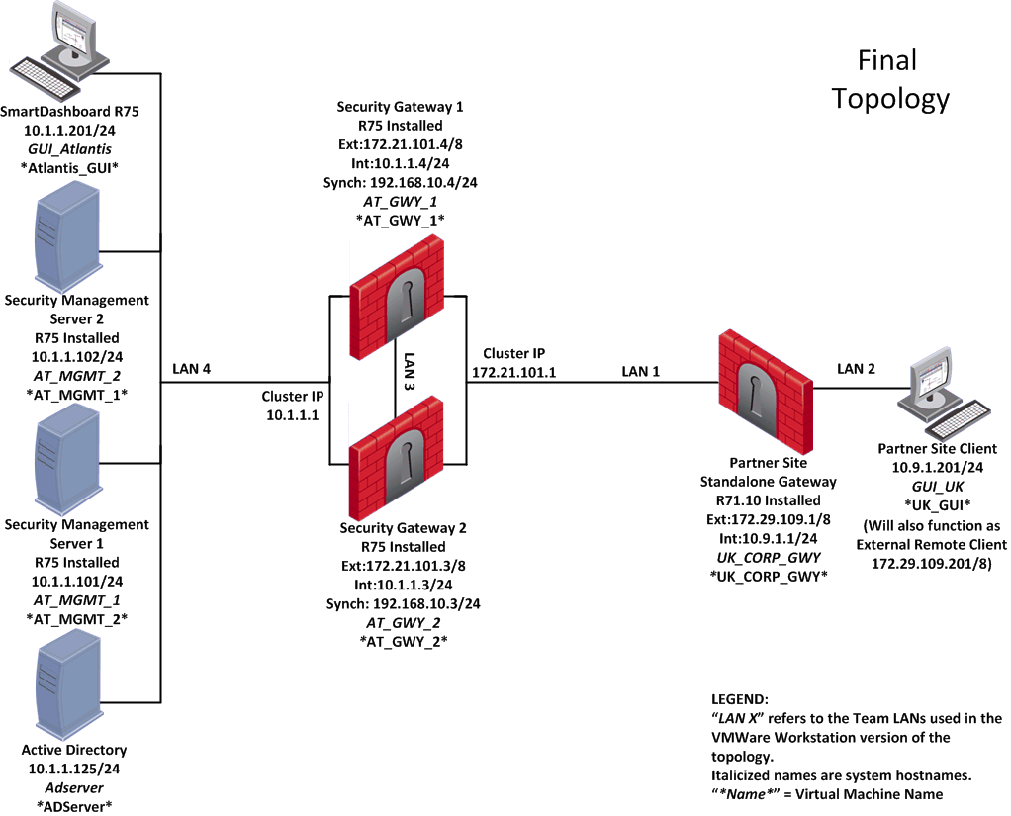
R75 CCSE
Final Lab Topology
Notes:
The largest change is the addition of the two extra machines in the clustering and Management HA configurations, but there are also some IP Address re-assignments that are noted in the topology map.

Slide 13

CCSE R75 New Classroom License
CPSB-EVAL-TRAINING
  6 month evaluation license
  Activates all features for labs
Contact Toni with your User Center account number and request for this new evaluation license SKU
Notes:
As the first lab for the CCSE R75 is an upgrade of an existing installation, a new license SKU has been created by training to reduce licensing maintenance cycles for classroom topologies.

Slide 14
Training Blades
  Mark Hoefle is our presenter for the new Training Blades and course overview

Slide 15

New Blade Training Courses
Application Control Blade
DLP Blade
IPS Blade (Coming Soon)
Mobile Access (Coming Soon)
Gaia (Coming Soon)
Notes:
The new Check Point Blade training courses are short, modular courses that provide instruction on the latest Check Point blade architecture security solutions. Check Point software blade are the logical independent, modular security building block that are quickly enabled and configured into a solution based on specific business needs. And as needs evolve, additional blades can be quickly activated to extend security to an existing configuration within the same hardware foundation.
These new blade training courses provide Check Point Security Administrators with a fast-track training option to maintain an up-to-date critical network security knowledge base on Check Point network security tools and options, and at the same time provides the optimum path for Check Point Security Administrators to keep their Check Point Training Certificates current.
Instead of having to repeat extensive and expensive CCSA or CCSE training to replace an older, out-of-date certificate with a new certificate, and then redo in a few years, as Check Point software evolves, now Certified people have the new option of on-going continuing education, taking various short Check Point Blade training courses, which will maintain their Check Point Certification as current.

Slide 16

New Blade Training Courses
Self Study
ATC Instructor Led
Notes:
These Blade Training Courses come in two flavors, self-study, and ATC delivered.
The self-study version consists of m4v instructional video files, and a PDF practice guide that walks the student through some simple practical blade related tasks, which can be done using just the Check Point SmartDashboard GUI in Demo mode.
The ATC Instructor led version includes all the m4v instructional video files that the self-study version does, along with instructional PowerPoint slides that mirror the instructional content video presentation, and a PDF lab guide. The ATC lab guide provides in-depth hands-on practice labs not available to the self-study student, and which are more appropriate to hands-on guided instruction, an important value-add. ATC instructors have the option of using the m4v video files during their instruction, or the PowerPoint slides, or a combination.
Each Blade Training course should be easily “teachable” in a day, giving ATCs the option of adding additional training-days onto their three-day CCSA or CCSA training offerings, and/or setting up individual day or evening classes for additional customer training options.
Each Training Blade course includes a testing/certification component as part of the course – so their is no additional student certification testing fee cost to obtain course credit toward their Check Point certificate maintenance. ATCs can even arrange for their students to do their course-completion certification test as part of the class, at the ATC, offering a one-stop train-and-certify package to prospective students.
The Blade Training Certification Exam is delivered on-line, via the Internet, with no need to schedule a specific exam time, or take the exam at a testing center.

Slide 17
Certification Update
  Karen Pavis (on behalf of Ken Finley) will be our presenter for the Certification update.

Slide 18
Faster Certification Renewals
Easy re-certification is available to all Check Point Certified Professionals - regardless of version level - with our new Training Blades
R6X Certified?
Take an accelerated R71 Update Training Blade to certify in software blade technology.
R70 Certified?
Take 2 Training Blades to renew your certification.
Or upgrade to a higher level.
Notes:
Ok now we’re onto the new certification program that includes faster Certification Renewals – and how ATCs can leverage this to create new training opportunities that help our customers keep their security skills current and update their certifications at the same time.
We changed the Certification Rules so that students don’t have to start all over with every product release. These new rules apply to EVERYONE who ever achieved a Check Point certification. We have thousands of students still certified on R6X and we want to bring them up to speed on the benefits of software blade technology. So we have our accelerated courses and exams that teach only the new technology. We updated the content and reduced the price of the CCSA&CCSE R71 Update books to $249 each (before your discounts) and exams cost students just $75 each at Pearson VUE. So we’re really encouraging students to update their certifications. ATCs can play a KEY role helping the huge population of R65ers get up to speed on the latest technology by taking advantage of the reduced course prices and running these Update classes.
So the new certification rules go like this: if you are CCSA R65 you can take the CCSA R71 Update Training Blade to get up to speed on the latest security advancements.
Similarly if you are CCSE NGX you go right into the accelerated CCSE R71 Update Training Blade to update your Security Expert knowledge.
For those who are already R70 certified – this is where it gets really easy- all they have to do is take 2 Training Blades to extend their certifications for 1 year, every year until the next major release.
We have all this information detailed out in a chart for you on the Training website -> Certifications tab. Now let’s get into the Training Blades.
18

Slide 19
R71 Update – Training Blade Courses
The R71 Update Training Blades (CCSA and CCSE) are part of the “fast track” for students with older certifications to get up to speed on the software Blades architect without lecture or theory.
There are approximately 35,000 certificated Check Point professionals that are “Pre-R70/71” certified. This is a huge markets for ATC training!
Individuals with a Check Point certification “Pre-R70/71” can take the appropriate R71 Update Training and exam.
  The courseware cost has been reduced to $249 per kit
  The exam is $75
After achieving the R71 Update Certification, the student can use the Training Blade courses to extend their certification benefits
Notes:
Let’s focus more on the “update blades” and training opportunity.
After we analyzed data, we fount the list of “Current” certified people ~2000. These are individuals at certified at R70 and above (and thus can benefit immediately from the continuous learning process, BUT are not anxious to re-certify as they are all current on their certification),
We also determined that ~ 35,000 people have pre-R70 certifications and most of them are not current – these people are a target audience our ATC community to offer the R71 Update Training Blade. Many of your past students will fit into this category. This is an opportunity to retrain them at an attractive price.
On a side note, at the Check Point eStore the R71 Upgrade kits are the current #1 item for sales. We are confidence this could be a big audience for your training team.

Slide 20
Mobile Learning Training Blades
NEW!
Technical training on-the-go
Downloadable video-based training/labs/exam bundle
Rapid Software Blade technical training and certification
    Available now:
    Application Control and DLP
    Coming Soon
    IPS, Gaia, Mobile Access
ATCs can leverage Training Blades to supplement their training curriculum and help students renew their certification
Notes:
Ok review our new Training Blades option, to help clarify their value to our ATC partners. The idea behind Training Blades is to provide single-topic learning lessons that empower people to keep up with technology AND renew their certification at the same time.
Most Training Blades are developed in m4v video format that can be downloaded to personal devices for anytime learning. But some Training Blades include an actual book – like the R71 Update Training Blades we just talked about.
ATCs can use Training Blades in a variety of ways to supplement your own curriculum:
Add all or part of a Training Blade to an existing CCSA or CCSE course
Run 1 or 2 Training Blade classroom sessions (or distance or remote) using all or part of the Training Blade files and offer testing service
Sell Training Blades to your students for your own price (you have the resource files)
Use Training Blades as a promotional tool to create demand
Facilitate certification renewals by offering fast, convenient certification updates
Training Blades retail for just $249. Retail downloads include a 1 hour video lecture, 6 hands-on lab exercises and an online exam delivered thru Check Point.
ATC Training Blade files include the videos and labs and the additional instructor content discussed earlier, along with customer case studies and product testimonials to enhance the learning experience.
ATCs have free access to all training blade resources and can purchase exam vouchers in packs of 3 for $249.
20

Slide 21
ATC Partner Update
  Toni Ponder is our presenter for the ATC Partner update.

Slide 22
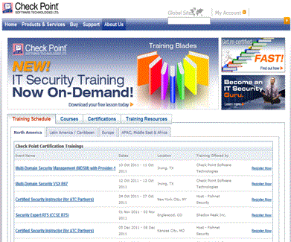
Marketing Initiatives
Re-designed Training & Certification web site
Promoting current training, courses, certification and training resources
Notes:
We have redesigned our Training & Certification web page to promote R75 training, mobile/on-demand training blade and faster certification update. We will continue to update this site with new information.
The new design is an offering a “1-stop-shop” for students to buy classes and training materials. Some classes are delivered by ATC, other are delivered by Check Point. Check Point is no longer delivering the CCSA or CCSE courses as a public offering.
If you are interested and want to join the “joint marketing effort” in which we sell their classes, let me know. The are minimum program requirements for this ATC feature that I can discuss with you.

Slide 23
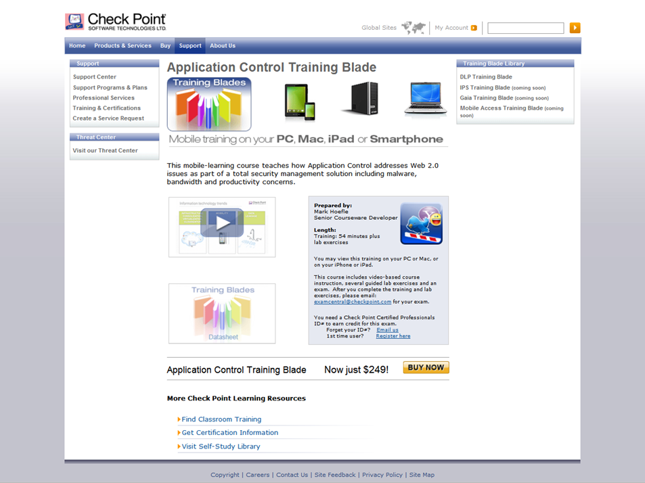
Course Description
Notes:
We are excited about the new Training Blade and mobile learning concept. As Mark and Karen mentioned, we have developed new training delivery for the blade architecture and faster re-certification for engineers. This is snapshot of the Application Control Training Blade course description

Slide 24
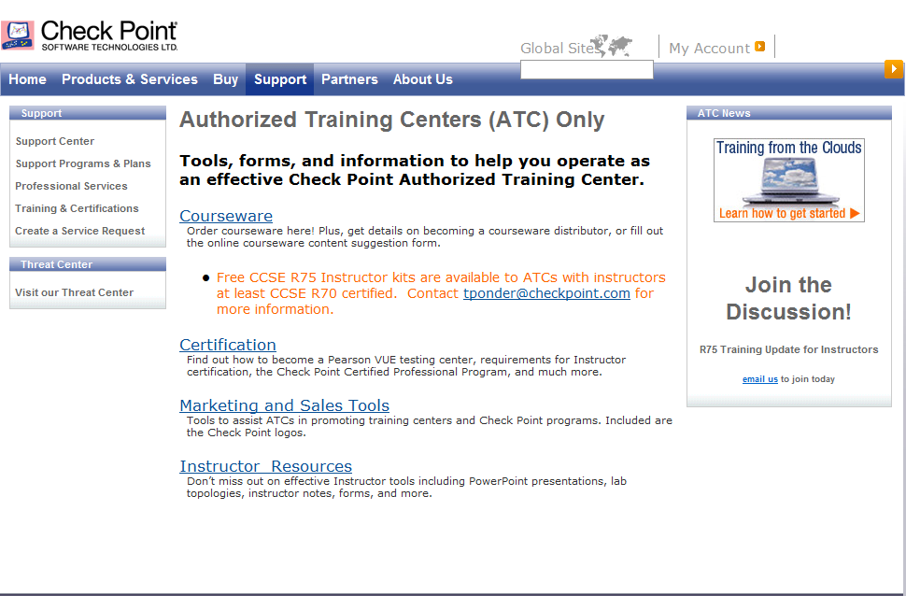
Online Resources - ATC Partner Portal
Notes:
24
24
24
24
Moving forward, lets review the latest updates to your ATC partner portal. The 3 main modules of the ATC Partner site are – Marketing/Sales Tools, Instructor Resources, and Courseware. The following slides will review points of each module.
(*) In order to access this site, you will need to be listed as an user in your company’s ATC PartnerMAP account. If you have questions regarding your permissions, please let me know.

Slide 25
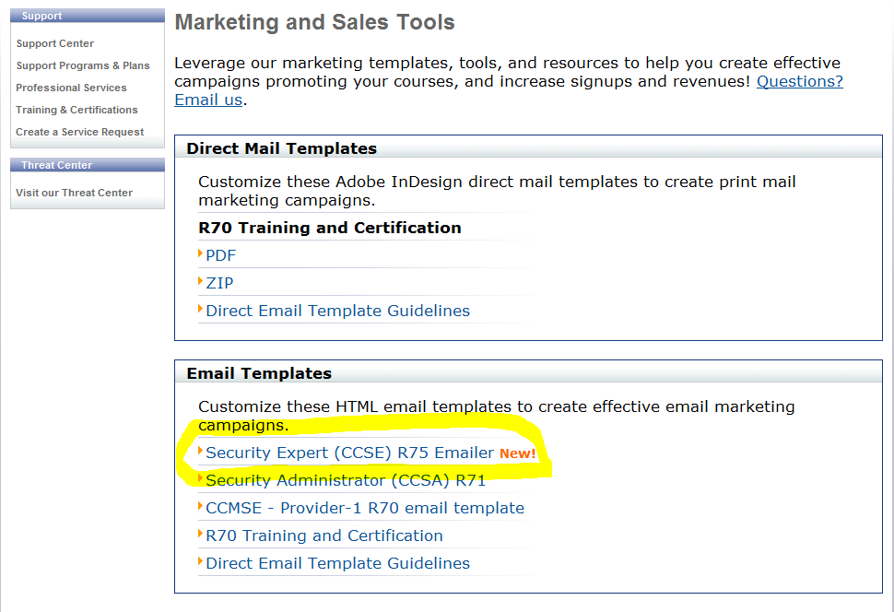
Online Resources - Marketing
http://www.checkpoint.com/services/education/atc/marketing/index.html
Notes:
Marketing and Sales Tools –
Various tools to assist ATCs in promoting training centers and Check Point programs. Included are the Check Point logos, email templates, co-branded collateral, classroom posters, etc.
You can use the Adobe Professional software to edit the templates include your partner information for co-branding marketing material.
The R75 CCSA marketing material is in the final preparation stage. Please check out to this site for that information in the near future.

Slide 26
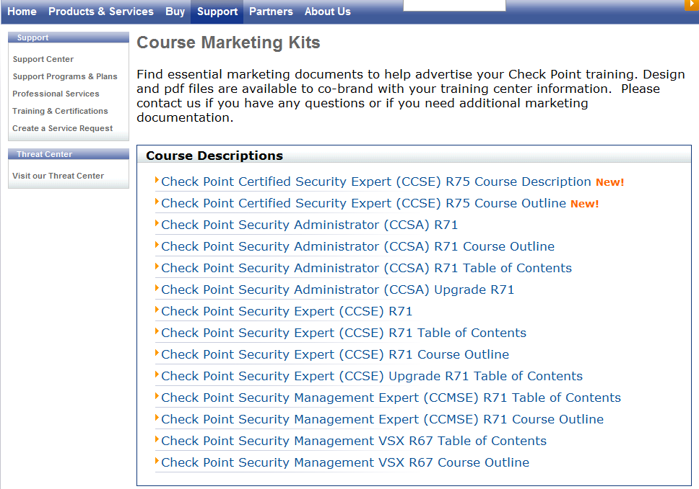
Marketing Kits
http://www.checkpoint.com/services/education/atc/course-marketing-kits/index.html
Notes:
More course marketing material for the Check Point training courses. All are downloadable for your marketing plans.

Slide 27
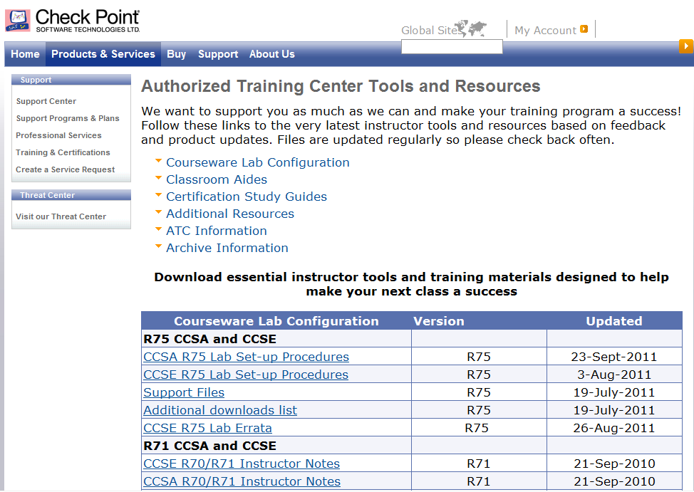
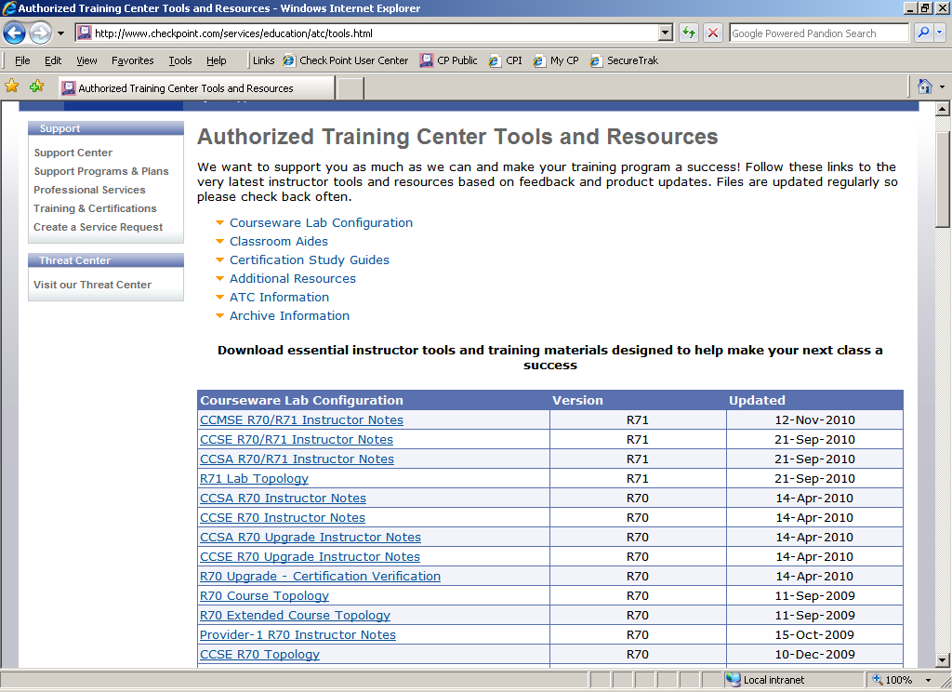
Online Resources - Instructors
Notes:
The Instructor Resources module is designed specifically for our ATC instructors. Instructor tools including PowerPoint presentations, lab topologies, instructor notes, forms, and more are located at this site.

Slide 28
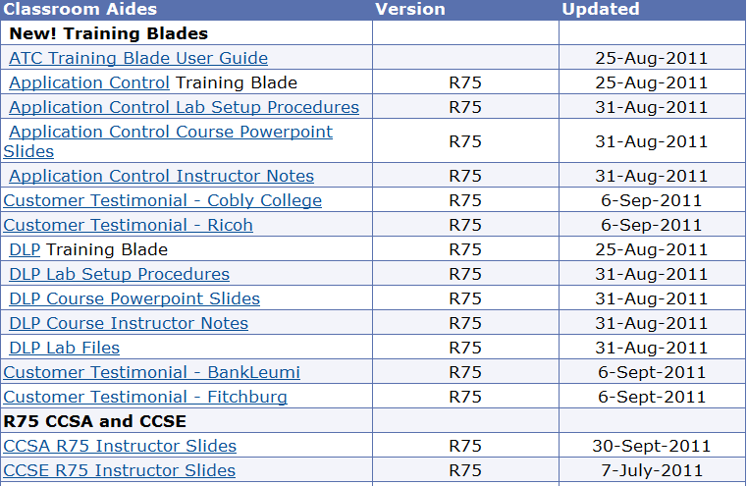
Online Resources - Instructors
Notes:
The new Training Blade video, lab procedures, and PowerPoint slides are located the “Classroom Aides” section of the Instructor Resources. Don’t forget to download the User Guide for the Training Blade. This guide provides instructions on how to deliver the course, what to order from courseware order form for exam vouchers and how to contact Check Point for exams.

Slide 29
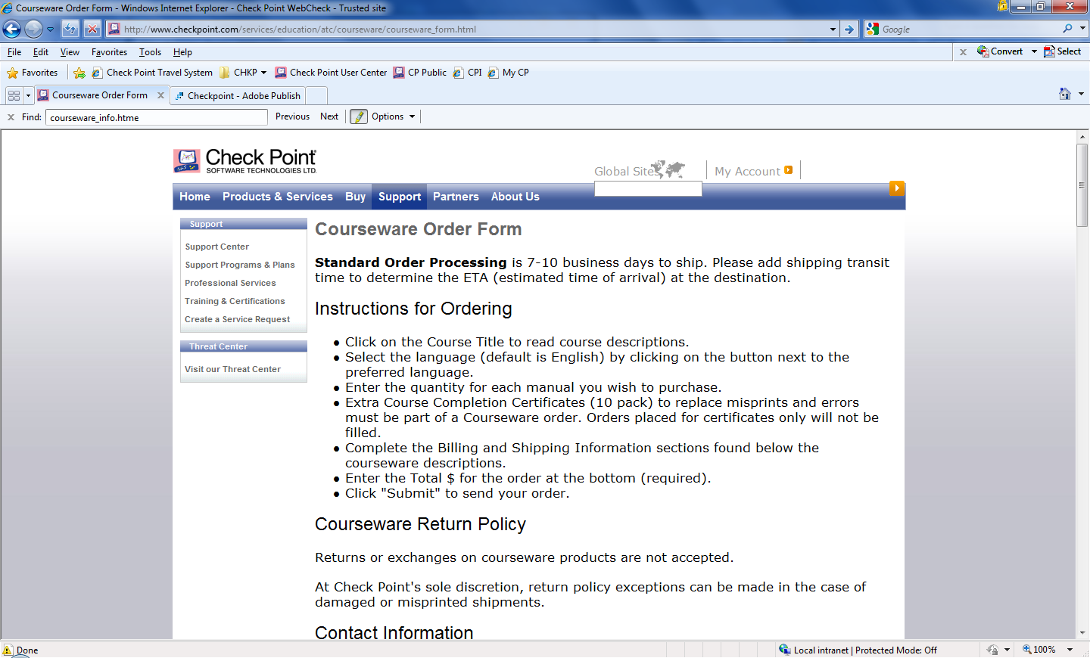
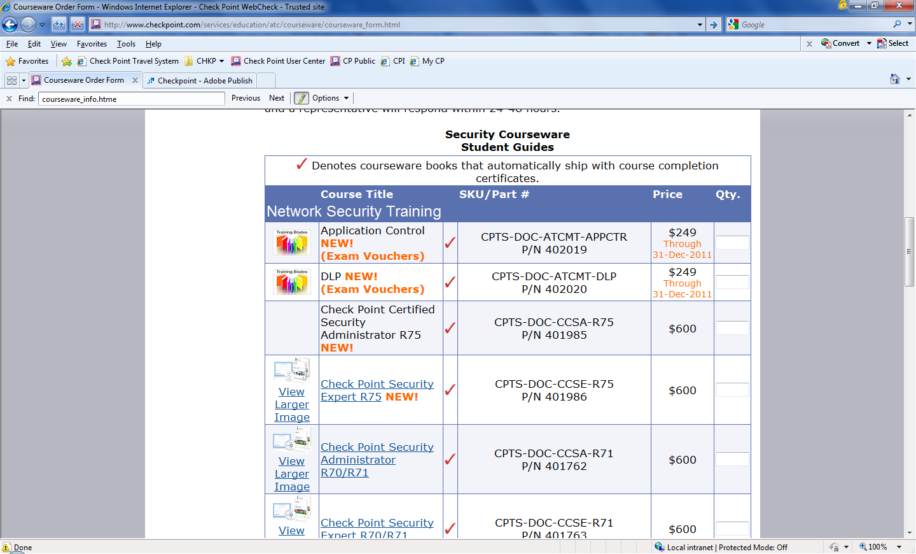
Online Resources - Courseware
Notes:
Last but not least, the Courseware Order Form -
This is location to order courseware for your training courses. The second screen shot shows the new R75 training material on the order form. These items are available and ready for you to order.
To summarize the Training Blade purchase and exam process, see below.
Training Blade Exam Process
1. ATC downloads free Training Blade materials from ATC website
2. ATC purchases exam bundles on ATC order form
3. ATC forwards the order confirmation email listing the Training Blade purchase to: examcentral@checkpoint.com for exam vouchers
4. Examcentral responds to the ATC with exam vouchers and user instructions
5. Students need a Check Point Certified Professionals ID# from VUE for exam credit.
a. Contact accountservices@checkpoint.com if they forgot their ID#
b. New users go to http://www.vue.com/signin_en/ to create a new ID#.
6. Exams are “low-stakes” self-administered, but can be proctored in the classroom
a. Note - some exams like the Update exams are still available at VUE

Slide 30
Training Blade FAQ
Are the training blades for free? Or do all of them cost $249 each?
  ATC partners have access to the training blade at the ATC partner portal (instructor resources section) to download. The exam vouchers are the purchase item. For $249, you receive three exam vouchers for students.
Exams are “low-stakes” self-administered, but can be proctored in the classroom. What does this mean?
  Training Blade exams are internet based. It is more convenient for the student to take the training and the exam together.
Are Training Blade exams administered by Check Point?
  Yes, the “ExamCentral” email alias is the first step to receive login credentials to the exam.
How long are the exams?
  Training Blade exams consist of 60-70 questions
If ATC is buying the Vouchers for $249/bundle of 3, where can it be used?
  ATC partners are to purchase exam vouchers for all students attending a Training Blade training.
Can the Training Blade material at the Instructor Resources site be given to students?
  Yes, material can be printed and distributed to student. Also included with the material is the exam voucher.
What is the time to deliver a Training Blade course?
  Training Blade courses conducted at an ATC site, using the additional instructor tools, will take 4-6 hours to complete.
Notes:
These are some questions I have received concerning the new Training Blade material and exam process.
If you have other questions not related to these, please send them to me. We will address your questions and provide a response to the ATC partner community.

Slide 31

Content Changes – 2011-2012
Wider
3D training approach
More products
Training Blades
Deeper
Advanced technology training
Understanding vs. Operating
Notes:
31
31
31
31
Looking forward ….

Slide 32

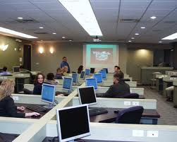
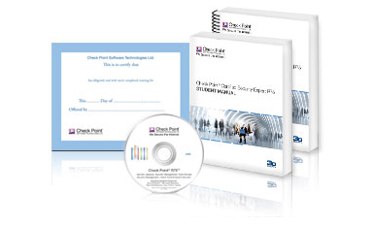


ATC Impact
Notes:
32
32
Check Point's Authorized Training Center (ATC) Program is a valuable relationship dedicated to providing quality, convenient access to the latest training on Check Point products to customers around the world.
Check Point and ATC partners contribute directly to each other's success through dedicated marketing and sales programs that create valuable revenue opportunities while meeting the needs of our customers.
Thank you for input and support.
32

Slide 33
Contact Information
Courseware Content - courseware@us.checkpoint.com
Certification - certification@us.checkpoint.com
ATC - atc@us.checkpoint.com
Ronen Koehler, Head of Education Services - rkeler@checkpoint.com
  New Address:
6330 Commerce Drive, Suite 120
Irving, Texas 75063
Notes:
33
33
33
33
How to contact the Education Services team. We have moved to a new facility in Irving, Texas. The new address is listed. Our phone numbers did not change.

